Slide 1
CSS
Introduction to cascading stylesheet
Types of cascading Stylesheet
CSS Properties- Background & Color, Text, List, Box, Border, Padding, Margin, Font Properties
CSS Advanced(Grouping, Dimension, Display, Positioning, Floating,Align, Pseudo class, Navigation Bar)
Creating page Layout and Site Design
Overview of CSS2 & CSS3

Slide 2
why stylesheets (CSS)
CSS is an acronym for Cascading Style Sheets
CSS is a style language that defines layout of HTML documents
CSS covers fonts, colours, margins, lines, height, width, background images, advanced positions and many other things.
HTML is used to structure content
CSS is used for formatting structured content.

Slide 3
why stylesheets (CSS)
CSS is an acronym for Cascading Style Sheets
CSS is a style language that defines layout of HTML documents
CSS covers fonts, colours, margins, lines, height, width, background images, advanced positions and many other things.
HTML is used to structure content
CSS is used for formatting structured content.
CSS allows to control layout of many documents from one single style sheet
CSS allows to apply different layout to different media-types

Slide 4
The basic CSS syntax
Ex. We wand blue color at the background of web page
Code using HTML : <body bgcolor=“blue”>
Code using CSS : body{backround-color:“blue”>
Selector : What HTML tag the property apply to
Value
Property

Slide 5
where do you put the css code?
There are three ways you can apply CSS to an HTML document.
In-Line Method(the attribute style)
Internal Method(the tag style).
External Method(link to a style sheet).

Slide 6
Example inline method
<html>
<head><title>frame1</title>
</head>
<body style="background-color:lightpink;color:orange“ >
<h1 style="color:green;font-size:15pt;font-family:Algerian;">
MIT World Peace University
</h1>
</body>
</html>
In-Line Method(the attribute style)
In-Line Method(the attribute style)

Slide 7
Internal CSS
p
{
font-family:"Times New Roman";
color:green;
text-align:left;
font-size:20px;
}
</style>
</head>
<body>
<h1>CSS example!</h1>
<p>This is a paragraph.</p>
</body>
</html>
<!DOCTYPE html>
<html>
<head>
<style>
body
{
background-color:black;
}
h1
{
color:orange;
text-align:center;
}

Slide 8
External CSS
demo.css
Demo.html
<html>
<head><title>frame1</title>
<link rel="stylesheet" type="text/css" href="demo.css"></link>
</head>
<body>
<h1>
MIT World Peace University
</h1>
</body>
</html>
body
{
background-color:black;
}
h1
{
color: Orange;
font-family: "Times New Roman";
}

Slide 9
css properties : Font Properties
Property | Description | Values
font-style |  | italic/oblique /normal
font-variant |  | small-caps, normal
font-weight |  | normal/bold
font-size | size of the font in pixels
font-family

Slide 10
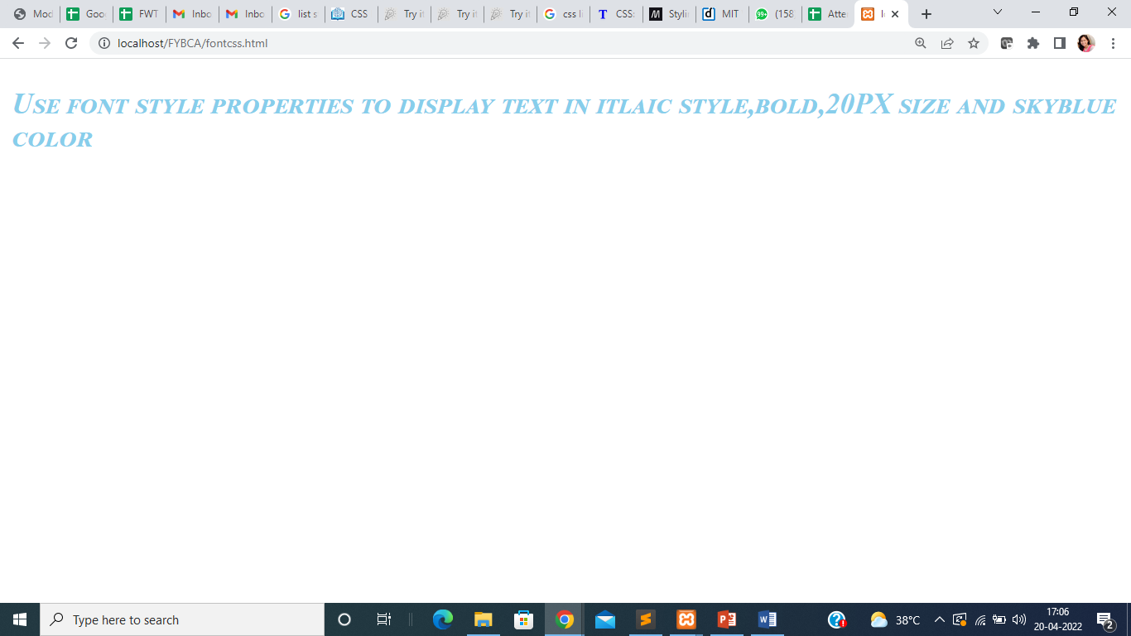
CSS font properties
<!DOCTYPE html>
<html>
<head>
<style>
#font{
font-style: italic;
font-variant :small-caps;
font-weight: bold;
font-size : 20PX;
color: skyblue;
}
</style>
</head>
</html>
<body>
<p id="font">
Use font style properties to display text in itlaic style,bold,20PX size and skyblue color and capital letters
</p>
</body>
Output

Slide 12
css properties : Text Properties
Property | Description | Values /Example
color | Foreground color of the text content of an element
letter-spacing | Amount of space between characters of text | P{ letter-spacing: 5px;}
text-align | Align text within the parent block element | Left/right/center
text-decoration | Text formatting of an element | Underline/overline/line-through
text-indent | the amount of horizontal spacing (ie: left to right) that will appear in front of the first line of an element's text.
text-transform | Capitalize the text of an element such as uppercase, lowercase, capitalize
word-spacing | Amount of space between words

Slide 13
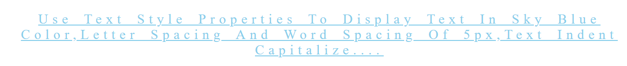
CSS text properties
<!DOCTYPE html>
<html>
<head>
<style>
#text{
color: skyblue;
letter-spacing: 5PX;
text-align: center;
text-decoration: underline;
text-indent: left;
text-transform: capitalize;
word-spacing: 5PX;
}
</style>
</head>
<body>
<p id="text">
Use text style properties to display text in sky blue color,letter spacing and word spacing of 5px,text indent capitalize....
</p>
</body>
</html>
Output

Slide 14
css properties : List Style Properties
Property | Description | Values /Example
list-style-image | Image to use as the list item marker | Ex. ol { list-style-image: url("/images/symbol.gif"); }
list-style-position | Position of the list item marker in the principal block box | Inside/outside
list-style-type | Appearance of a list item element | Disc/circle/square/decimal/lower roman/lower-alpha/upper-alpha

Slide 15
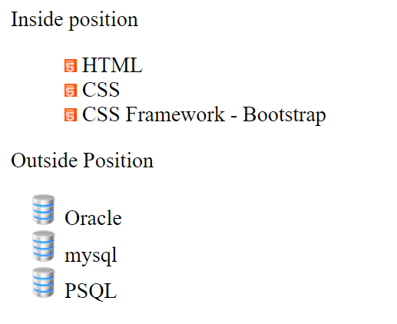
CSS list properties
<!DOCTYPE html>
<html>
<head>
<title>List style position</title>
<style>
#frontend{
list-style-position: inside;
list-style-image: url("frontend.png");
}
#backend{
list-style-position: outside;
list-style-image: url("db.png");
}
</style>
</head>
<body>
<div>
Inside position
<ul id="frontend">
<li >HTML</li>
<li>CSS</li>
<li>CSS Framework - Bootstrap</li>
</ul>
</div>
<div>
Outside Position
<ul id="backend">
<li>Oracle</li>
<li>mysql</li>
<li>PSQL</li>
</ul>
</div>
</body>
</html>
Output

Slide 16
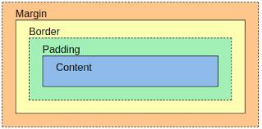
css properties : box Properties

Slide 17
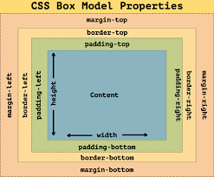
css properties : box Properties

Slide 18
css properties : Box Properties
Property | Description | Values /Example
height | Height of the content area of an element | In pixels/percentage
width | Width of the content area of an element | In pixels/percentage
margin | Margin on all sides of an element | In pixels/percentage
padding | Padding is space between the outer edge of the content to the inner edge of the border. | In pixels/percentage
overflow | Behavior when content overflows the content box | Visible/hidden/scroll/auto
border | The border is the space between the outer edge of Padding to the inner edge of the margin.

Slide 19
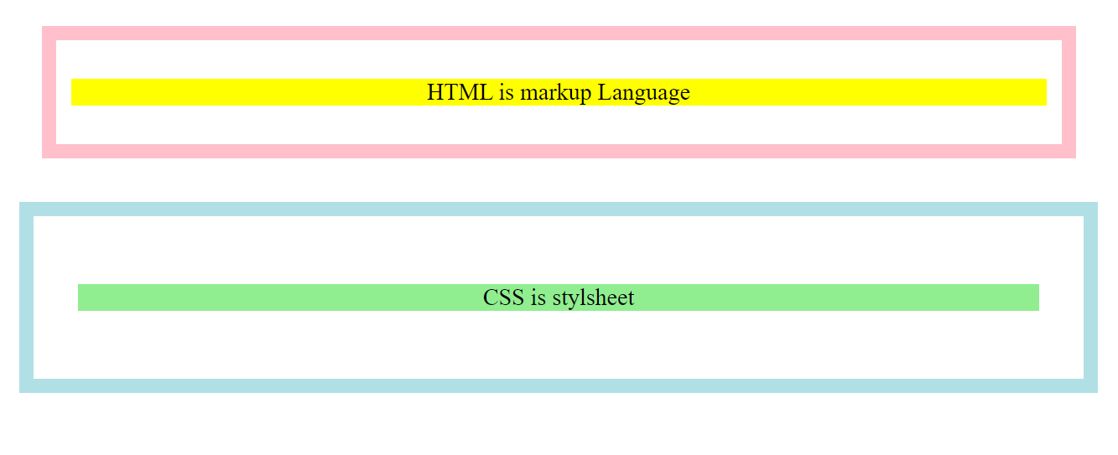
CSS text properties
<!DOCTYPE html>
<html>
<head>
<style>
#box1 {
padding: 10px;
border:10px solid pink;
margin: 30px;
}
#box2 {
padding: 30px;
border:10px solid powderblue;
margin: 15px;
}
</style>
</head>
<body>
<div id="box1">
<p style=background-color:yellow;text-align:center;>HTML is markup Language
</p>
</div>
<div id="box2">
<p style=background-color:lightgreen;text-align:center;>CSS is stylsheet
</p>
</div>
</body>
</html>
Output

Slide 20
css properties : Border Properties
Property | Description | Values /Example
border-style | to set the design of the border. | Solid/ dashed /dotted/double/ridged/ groove…… Ex. border-style: solid;
border-color | to set the color of the border. | border-color: deeppink;
border-width | to set the width of the border. | border-width: 20px;
border-image | To use image for border Border percentage of slice border image repeated,rounded,spaced or stretched | border-image: url("border.png") 20% round;
border-radius | To set round borders
border | Width style color | border:10px solid powderblue;

Slide 21
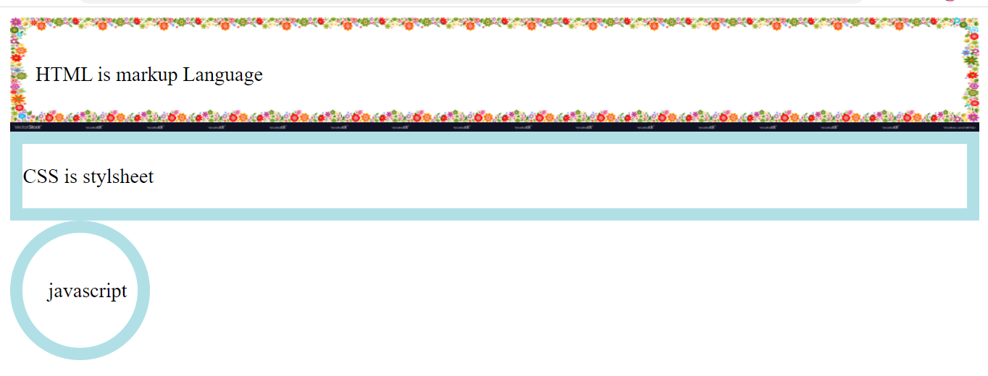
CSS border properties
<body>
<div id="box1">
<p>
HTML is markup Language
</p>
</div>
<div id="box2">
<p> CSS is stylsheet
</p>
</div>
<div id="box3">
<p> javascript
</p>
</div>
</body>
</html>
<!DOCTYPE html>
<html>
<head>
<style>
#box1 {
border-width: 20px;
border-color: deeppink;
border-image: url("border.png") 20% round;
border-style: solid;
}
#box2 {
border:10px solid powderblue;
}
#box3 {
border-radius:50%;
border:10px solid powderblue;
padding: 20PX;
height: 50Px;
width: 50px;
}
</style>
</head>
Output

Slide 22
css properties : Table Properties
Property | Description | Values /Example
width | Width of table, column and row
height | Height of table, column and row
border-collapse | This collapses or seprates all the borders into a single border | Th,td {border-collapse: collapse;}
padding | sets the space between the borders of the table & the content of the table. | th, td { padding: 10px; }
color | Font color | th, td { color: Orange }
background | Background color | background:black;

Slide 23
css properties : Table Properties
Values /Example
To add color for specific column td:nth-child(3) { background-color: orange; color:black; }
2. To add color for specific row tr:nth-child(2) { background-color: tomato; color:white; }

Slide 24
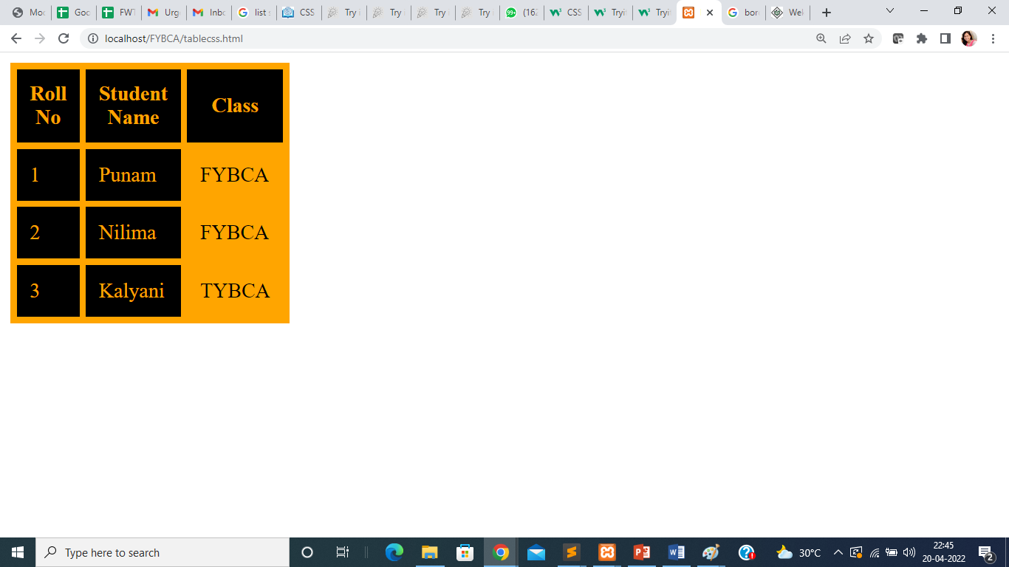
CSS table properties
</head>
<body>
<table>
<tr>
<th>Roll No</th>
<th>Student Name</th>
<th>Class</th>
</tr>
<tr>
<td>1</td>
<td>Punam</td>
<td>FYBCA</td>
</tr>
<tr>
<td>2</td>
<td>Nilima</td>
<td>FYBCA</td>
</tr>
<tr>
<td>3</td>
<td>Kalyani</td>
<td>TYBCA</td>
</tr>
</table>
</body>
</html>
<!DOCTYPE html>
<html>
<head>
<style>
table, th, td {
border: 5px solid orange;
border-collapse: collapse;
background:black;
color:orange ;
width :20px;
Height: 20px;
}
th, td {
padding: 10px;
}
td:nth-child(3)
{
background-color: orange;
color:black;
}
</style>

Slide 25
Advanced CSS
Features | Syntax/Attributes | Example
Grouping The CSS grouping selector is used to select multiple elements and style them together. | element, element { /*declarations*/ } | th,td {border-collapse: collapse;}
Dimesions CSS heigt and weight properties used to set dimensions for any THML element | auto - This is default. The browser calculates the height and width length - Defines the height/width in px, cm etc. % - Defines the height/width in percent of the containing block initial - Sets the height/width to its default value inherit - The height/width will be inherited from its parent value | div { height: 200px; width: 300px; }

Slide 26
Advanced CSS
Features | Syntax/Attributes | Example
Pseudo classes CSS pseudo-classes are used to add special effects to some selectors | selector:pseudo-class {property: value} List of some pseudo classes Some Pseudo-classes Link Visited Hover Active First-child etc. | <html> <head> <style type = "text/css"> a:hover {color: pink} </style> </head> <body> <a href = "">Bring Mouse Here</a> </body> </html>

Slide 27
clear property :
CSS Clear property is used to stop next element to wrap around the adjacent floating elements. Clear can have clear left, clear right or clear both values.
CSS Clear Both property does not allow any element to wrap around any adjacent Floating element.
Clear Left can stop wrapping around left floating element
Clear right can stop wrapping around right floating element.
Div tag is the preferred element to use clear both as div is block level.

